Slide 1
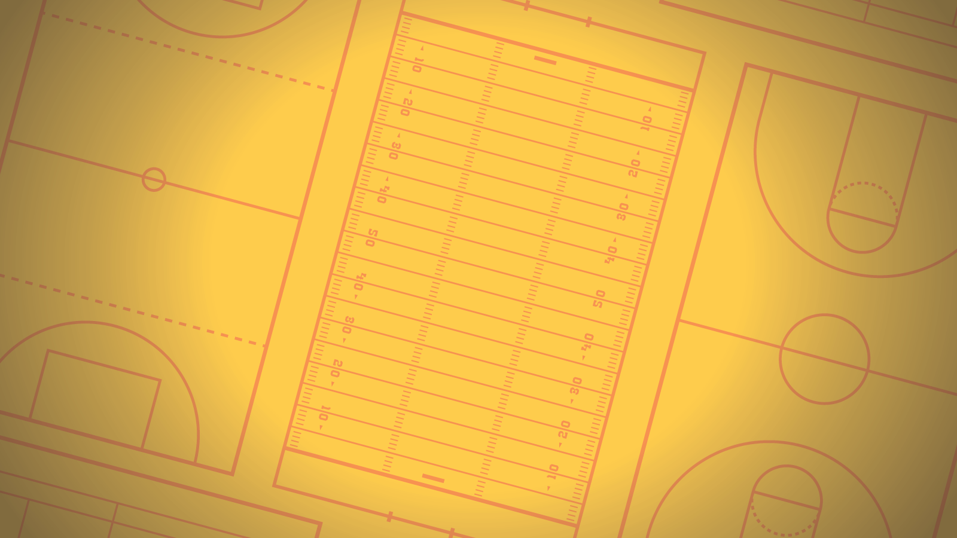
Avoiding Common Pitfalls with Async/Await

Slide 2
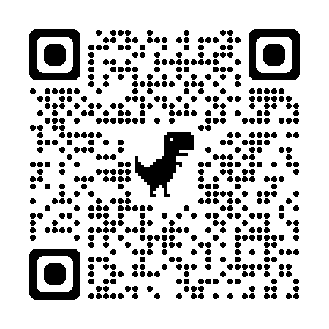
“This chapter tackles some challenging topics. You may not immediately understand everything. However, that is normal… Give yourself time. Let things rest. Reread some sections one or more days later.”
-Dr. Axel Rauschmayer, “Asynchronous JavaScript”
Notes:
København
Questions welcome!
Context: all .NET code. Many talks/blog posts assume either UI or ASP.NET context; we'll cover both.

Slide 3
Avoiding Common Pitfalls with Async/Await – Stephen Cleary
“This chapter tackles some challenging topics. You may not immediately understand everything. However, that is normal… Give yourself time. Let things rest. Reread some sections one or more days later.”
-Dr. Axel Rauschmayer, “Asynchronous JavaScript”
Notes:
København
Questions welcome!
Context: all .NET code. Many talks/blog posts assume either UI or ASP.NET context; we'll cover both.

Slide 4

Who is this guy?
Notes:
Most importantly: I don’t center my identity in being a developer. I don’t think AI will take over programming; but if AI takes my job, I would be disappointed but not devastated.
Microsoft MVP
Top async/await answerer on Stack Overflow
Assisted hundreds of companies with async adoption across all kinds of applications (available for contract work!)
Blog has been the go-to source for async advice for years
Contributor of some of the MS documentation on subjects such as ValueTask
Maintainer of AsyncEx, a library with >50M downloads which provides asynchronous coordination primitives and other async helper types

Slide 5
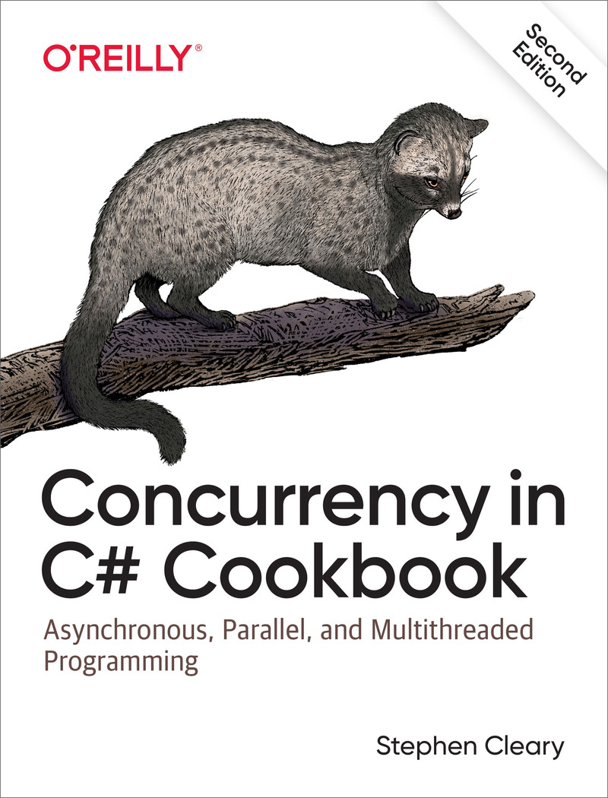

Slide 6
Async Syntax
Notes:
It’s 2025. People still don’t know how async/await works.
I even heard someone teach it wrong at a dev conference this year.

Slide 7
Async keyword: syntax
async Task DoNothingAsync()
{
// In the Real World, we would actually do something...
await Task.Delay(100);
}
The async keyword:
Enables the await keyword for that method.
Transforms the method into a state machine, similar to the yield keyword.
That’s it!
Notes:
The async keyword can only be applied to a method.

Slide 8
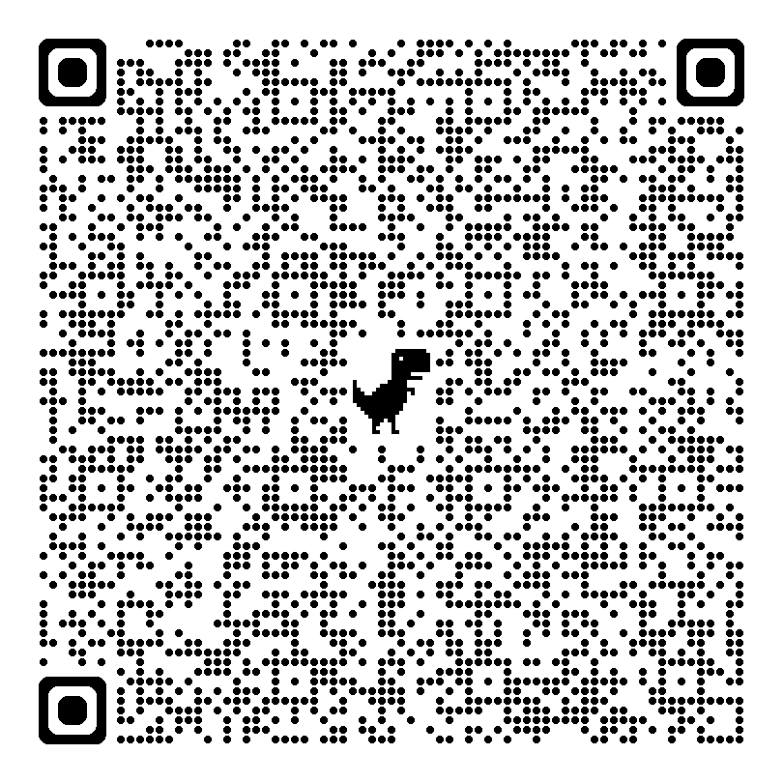
Async keyword: state machine
https://tinyurl.com/ycxnpskw
MoveNext() will be in your stack traces

Slide 9
Await keyword: awaitables
async Task DoNothingAsync()
{
// In the Real World, we would actually do something...
await Task.Delay(100);
}
async Task DoNothingAsync()
{
Task task = Task.Delay(100);
await task;
}
await
Takes a single argument.
Awaitable: Task/ValueTask (Future/Promise)
Notes:
“Await” is like a unary operator; it takes a single argument (like a cast). This argument is an “awaitable”.
An “awaitable” represents an asynchronous operation.
Technically, you don’t “await” a method; you call the method and then “await” the Task it returns. But “await a method” and “awaitable method” are common phrases.
- Another method can await the task returned from DoNothingAsync, not b/c the method is async, but b/c it returns a Task.
Async methods start synchronously; so this method will (synchronously) call Task.Delay and then await.
Await is where things can start to get asynchronous.

Slide 10
Await keyword: yielding execution
async Task DoNothingAsync()
{
// In the Real World, we would actually do something...
await Task.Delay(100);
}
If Task is complete, continues synchronously.
If Task is not complete, continues asynchronously:
Pauses the method and registers it with the task.
Then returns.
Notes:
The “registering” is saying, “when you complete, please resume this method” (using the state machine).
When DoNothingAsync returns, it returns an incomplete Task.
This Task is completed when the DoNothingAsync completes (end of method or “return” statement).

Slide 11
Await keyword: resuming execution
async Task DoNothingAsync()
{
// In the Real World, we would actually do something...
await Task.Delay(100);
}
Pausing and Resuming (when awaiting tasks)
Uses the state machine to resume at the right place.
Where to resume? UI, thread pool, etc.
Notes:
By default, a context is captured: SynchronizationContext or TaskScheduler.
Usually a SynchronizationContext for UI apps (or old-school ASP.NET), or else the thread pool.

Slide 12
Conceptual Mistakes

Slide 13
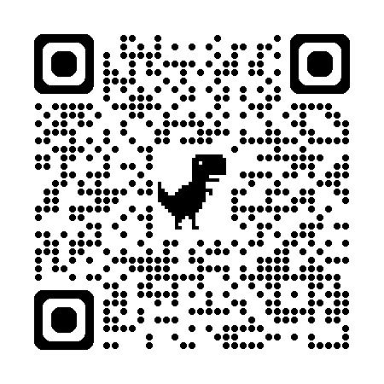
Confusing Parallel and Async
Await does not mean “run on the thread pool”
Parallel throws more threads at the problem.
“There is no thread”
- Me, 2013
Notes:
In fact, async/await reduces the number of threads used in your application.
You can do both async and parallel, but realize they work in different ways!

Slide 14
Using Async to “go faster”
Client | Server
Primary benefit: Responsiveness | Primary benefit: Scalability
Keep UI thread free | Minimize threads used to serve requests
Better UX | 10x-100x scalability (same box)
Nonblocking UI is required by some app stores | Faster response to bursting traffic
Notes:
The benefits for client and server are different, but both come from the same core: freeing up threads. (Not using more threads).

Slide 15
Three Conceptual Models that won’t mislead you

Slide 16
Conceptualizing Async: Task is the method
“await”: “asynchronous wait”
Task represents the method’s execution.
Completion
Results
Exceptions
await pauses the method’s execution.
Notes:
This is my default conceptualization, and the one I describe when first teaching async/await.

Slide 17
Conceptualizing Async: Types
Types: “wapper” / “unwrapper”
Task<T> is a future value of T async “wraps” future values into Task<T> await “unwraps” the future value from the task
(hint: async is almost a monad in functional languages)
Notes:
This conceptualization is useful when you are doing something functional and you need to figure out your types.
“I have a Task<string>. How do I get the string out of it?”
“If my function returns Task<string>, why do I return a string value?”

Slide 18

Conceptualizing Async: Callbacks
Callbacks
async chops up the method into a state machine, similar to the yield keyword
await identifies the dividing points where the method is chopped up
When await yields, it registers the next method chunk as a callback on the task
At runtime, the code stack inverts!
Call stack is not where your code came from; it’s where it’s returning to!
(and this is how the GC isn’t confused)
Notes:
This conceptualization is how async actually works, and explains how the GC works with async and why your call stack is “reversed”.

Slide 19
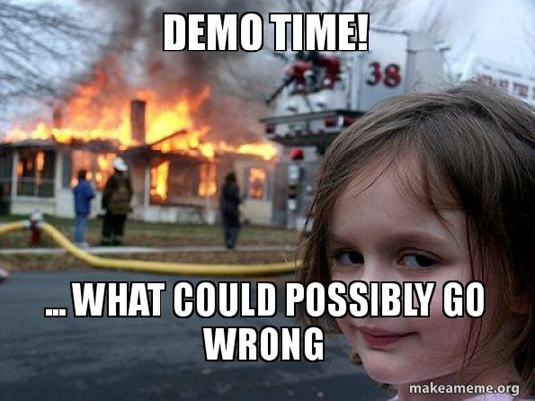
Notes:
Demo: Program.cs [ConsoleApp1], simple part of MainWindow.

Slide 20
Tip: Task is an object
Task is not magic.
Neither is ValueTask, but VT is a mutable value type, so it’s a bit trickier.
You can save it in a variable and await it later.
You can combine it naturally with (and in) other objects:
List<Task> (but beware IEnumerable<Task>)
Func<Task>
Lazy<Task<T>>

Slide 21
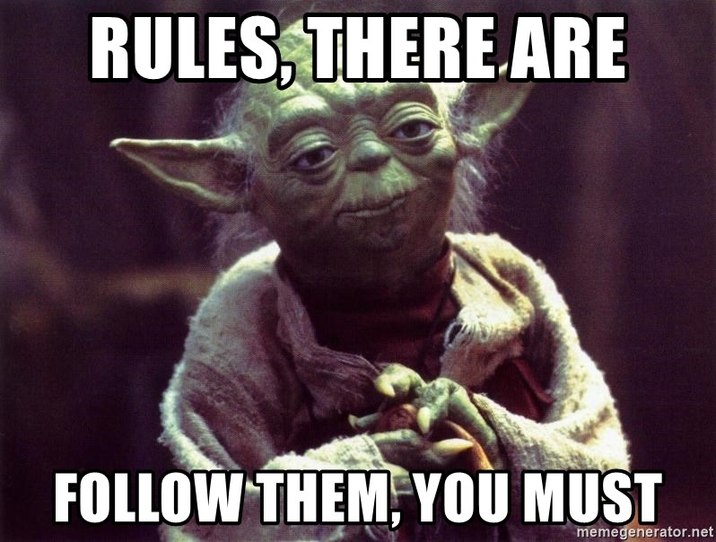
Rules Around ValueTask
Only consume once!
await – the 99% case.
Advanced: IsCompleted for fast path.
Cannot block!
.Result and .GetAwaiter().GetResult() will compile but may fail at runtime.
Even worse, they may work at runtime (block) and then fail at runtime after upgrade.
Need to bend the rules? AsTask()

Slide 22

Usage Mistakes

Slide 23
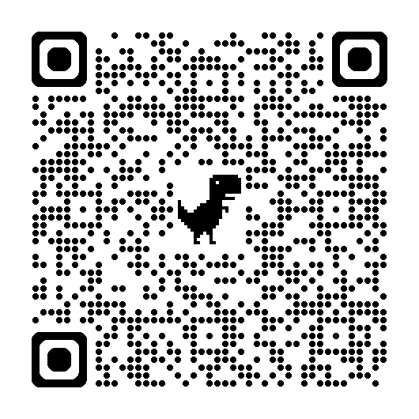
Avoid Async Void –Me, 2013
void is not a natural type for async methods:
Doesn’t represent execution.
No way to detect completion (shutdown, results).
Awkward error handling (no try/catch).
Doesn’t exist in other async/await languages.
Primary purpose: async event handlers.
Notes:
Async void is occasionally useful elsewhere, like processing loops in pipelines.
Violates: “Task is the method”

Slide 24
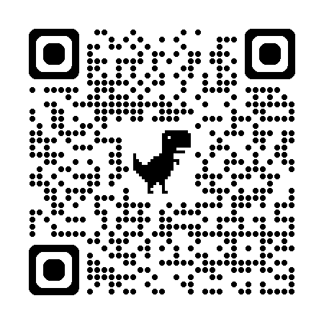
Blocking on Async Code
Can cause deadlocks
https://tinyurl.com/AsyncAllTheWay
When await pauses a method, it captures a context, and resumes the method in that context.
Some contexts only allow one thread at a time. E.g., UI.
Thread pool exhaustion
Blocking on async code uses a thread pool thread and then requires another thread pool thread to unblock!
Notes:
Violates: callbacks

Slide 25
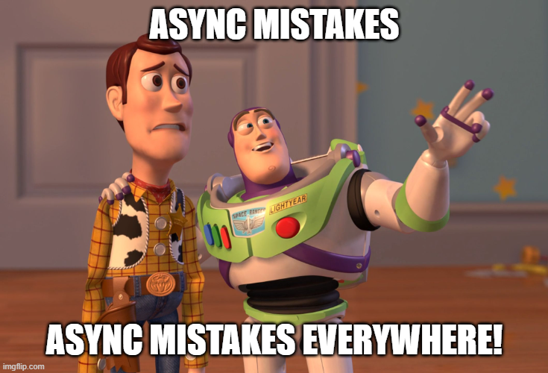
Many, Many More Mistakes

Slide 26
Notes:
Demo: MoreExamples

Slide 27
Common Mistakes
Fire and forget
Discarding the task is discarding the results of that function.
If you don’t care about the results of a function, then why are you calling it at all?
Without joining the execution (await):
Exceptions are ignored.
App can’t know when side effects have completed.
App can’t know when it’s safe to shut down / suspend.
Shutting down is normal behavior!

Slide 28
Common Mistakes
Dangerous Methods
The Task constructor should never be used. Ever.
StartNew and ContinueWith should almost never be used.
This means you.
ContinueWith => await
StartNew => Task.Run
Task constructor => Func<Task> / Task.Run
Notes:
Do you work for Microsoft? Do you have Stephen Toub on speed dial?

Slide 29
Common Mistakes
Side effects instead of returning results
Async will gently nudge you towards a more functional programming style. Don’t resist.
Stream.Position

Slide 30
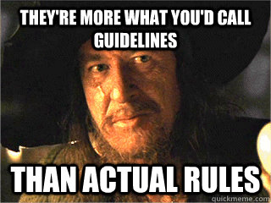
Common Mistakes
Eliding (removing) async/await in non-trivial methods
Exceptions become synchronous (not on the Task).
Disposal and try/catch don’t work as expected.
If you have any code other than calling another method, then NOT OK.
Using Task.FromResult? No.
Are you writing an overload? OK.
Is it an expression-bodied method? OK…
Notes:
FromResult is fine in mocks and other interface implementations if there is no asynchronous work to do.

Slide 31
Common Mistakes
WaitAsync(CancellationToken) to “cancel” a task
The token cancels the wait, not the task.
You should pass the token into the code returning the task.

Slide 32
Common Mistakes
Fake async methods
Method implementations wrapped in Task.Run are a code smell.
Call methods with Task.Run (if appropriate); don’t implement them with Task.Run.

Slide 33
Common Mistakes
Using WhenAny + Remove to process tasks as they complete.
Unnecessary O(N^2)
Best: compose async methods.
Better: Task.WhenEach
Good: OrderByCompletion from Nito.AsyncEx

Slide 34
Common Mistakes
Unnecessary callbacks
Task already has callbacks. Just use await.

Slide 35
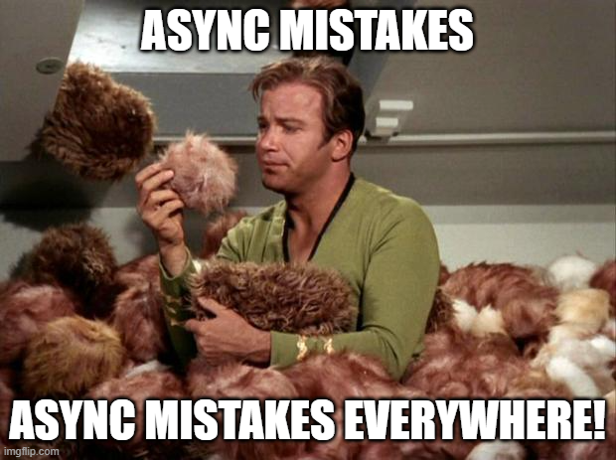
Bonus Round!

Slide 36
Common Mistakes
Using ConfigureAwait(false) to avoid deadlocks
Problems:
Have to use it everywhere! If you miss even one, you can deadlock in prod.
You’re still blocking the UI thread.

Slide 37
Common Mistakes
Async events: Strategy vs Observer
You find yourself wanting to allow asynchronous event handlers that cannot be async void. The event-raising code must (a)wait the handlers, possibly retrieving results.
Events are used to implement the Observer pattern.
Your code is using the Strategy pattern.
Notes:
Solution: The event shouldn’t be an event. It should be a method, probably on an interface. Replacing an interface with an event is a design shortcut that only works in the synchronous world.

Slide 38
Common Mistakes
These types already exist – you don’t need to reinvent them!
Cancellation: CancellationToken, CancellationTokenSource, OperationCanceledException
Progress reporting: IProgress<T>, Progress<T>
Consumer/producer queues: System.Threading.Channels
TPL.Dataflow is still around, too!

Slide 39
Notes:
Demo: Cancellation and Progress in MainWindow, ChannelsProgram

Slide 40
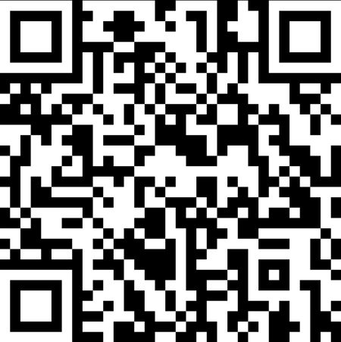
Q&A
Go forth and be awesome!
Notes:
Mange tak

